Slide 1

Movie TMDB Database
By- Aryan Khandelwal

Slide 2

Business Problem
The streaming platform aims to enhance user satisfaction and attract a wider audience by strategically addressing key challenges, including increasing the average popularity score and diversifying content across languages. The goal is to optimize content strategy, boost viewer engagement, and solidify the platform's competitive position in the streaming industry.

Slide 3

Business Solution
To address the streaming platform's challenges, a multifaceted solution involves implementing targeted marketing campaigns to promote popular content, expanding language-specific content creation or acquisition, and leveraging user data analytics to understand preferences better. Implementing strategies to encourage user reviews, such as incentivizing feedback or incorporating user ratings into content recommendations, is crucial.

Slide 4
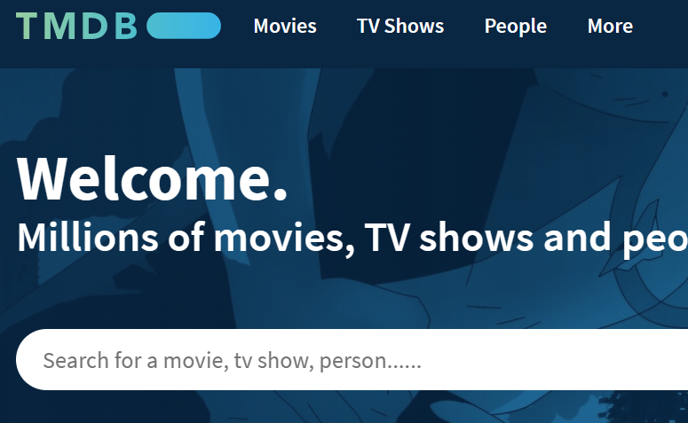
Technical Approach – Data Gathering
API Integration:
Utilized The Movie Database (TMDb) API to retrieve information on popular movies.
Implemented a Python script with the requests library to make API calls.
Configured the API calls with a base URL of "https://api.themoviedb.org/3/movie/popular?language=en-US&page=" and included an API key in the headers for proper authorization.
Data Retrieval and Aggregation:
Executed a loop through pages 1 to 300, making sequential requests to the API for each page.
Appended the retrieved data from each page to a list named all_data for aggregation.
This process involved collecting diverse movie information across multiple pages.

Slide 5
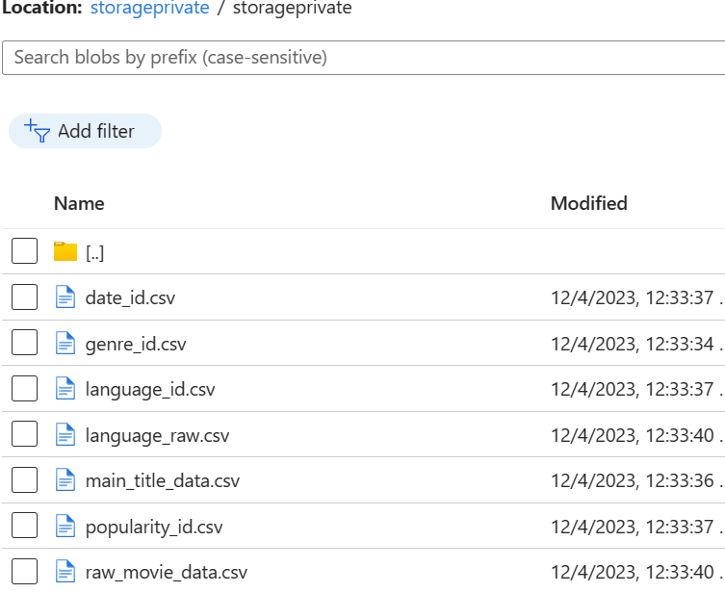
Data Storage – Azure Blob Storage
After aggregating the movie data, the next step involved seamless storage on Azure Blob. The raw data, gathered through The Movie Database (TMDb) API, was uploaded to a private storage container on Azure Blob. This step ensures secure and scalable storage for future reference and analysis.

Slide 6
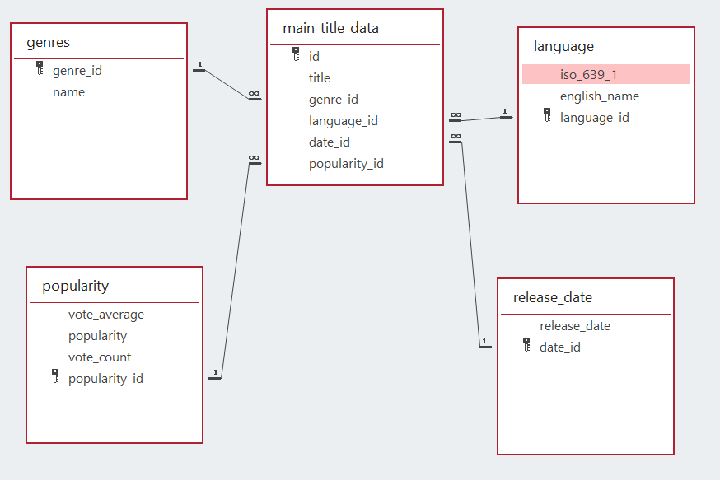
Modeling
Database Relationship Modeling in Microsoft Access:
In order to establish clear and comprehensible relationships within the database, I opted to utilize SQL queries to develop a database relationship model in Microsoft Access. This approach was chosen due to the inherent advantages of Microsoft Access in visually representing relationships, making it significantly easier to convey and understand the interconnected nature of the data.

Slide 7
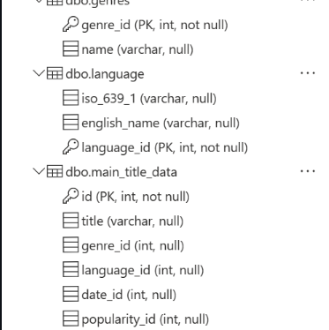
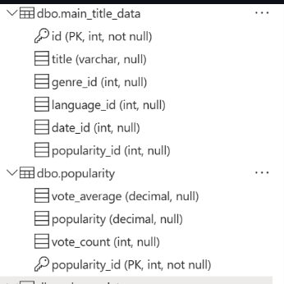
SQL Server and Azure Database
SQL Server Management:
Developed SQL code using SQL Server Management Studio to create a dedicated database for the project.
Executed the necessary SQL commands for database creation and configuration, ensuring a structured foundation for data storage.
Named the newly created database as 'akhan00142,' adhering to a systematic naming convention for clarity and project identification
The Image shows the keys, and columns within the tables, providing a comprehensive view of the data structure.

Slide 8

Transformation
Section 1: Data Setup
Libraries Import: Imports necessary Python libraries for data manipulation: pandas, ast, and datetime.
Section 2: Data Loading and Preprocessing
CSV Loading: Loads movie data from a CSV file into a Pandas DataFrame.
Column Drop: Removes specific columns from the DataFrame.

Slide 9

Data Transformation
Section 3: Data Transformation
Genre Extraction: Defines and applies a function to extract the first number from a list in the 'genre_ids' column.
Duplicate Removal: Drops duplicate rows based on the 'id' column.
Section 4: Date Processing
Date Conversion: Converts the 'release_date' column to datetime format.
Filtering and Sorting: Filters and sorts the DataFrame based on release dates.

Slide 10
Data transformation
Section 5: API Request and Data Processing
API Request: Fetches movie genre data from an API.
DataFrame Creation: Converts JSON data to a DataFrame, adds a new column, and saves the result to a CSV file.
Section 6: Uploading All the Data to Azure Blob
Upload Function:Uploads all the data to azure blob storage of my choice

Slide 11
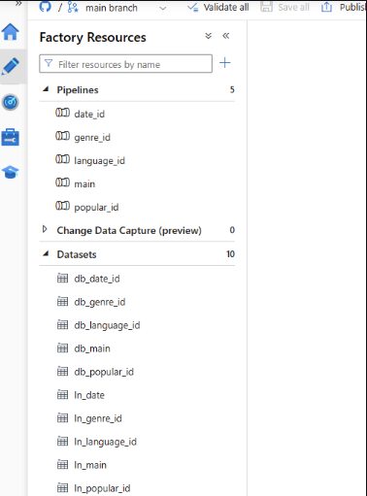
Database data uploading
Unified Loading Process:
Integrated Azure Data Factory for seamless loading of data into both the database's five tables and Azure Blob Storage from five CSV files.
Automated Data Pipelines:
Implemented five dedicated data pipelines within Azure Data Factory to orchestrate efficient data transfer between specific tables and CSV files.
Efficient Workflow Management:
Ensured a streamlined and automated data workflow, utilizing Azure Data Factory to manage the loading and transfer of data across diverse storage destinations.

Slide 12
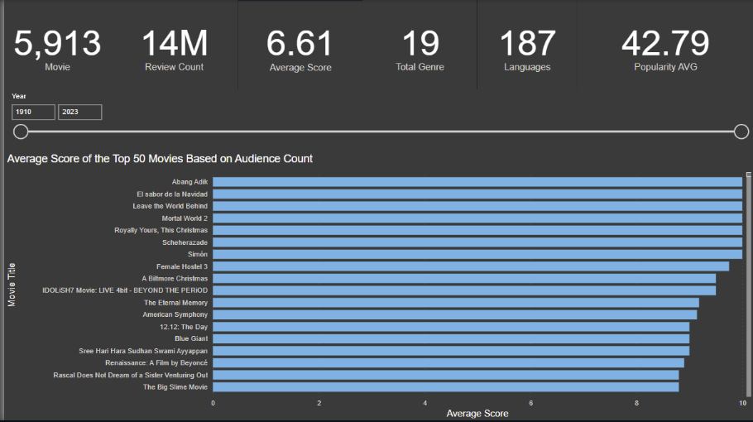
PowerBI – Github Repo

Slide 13
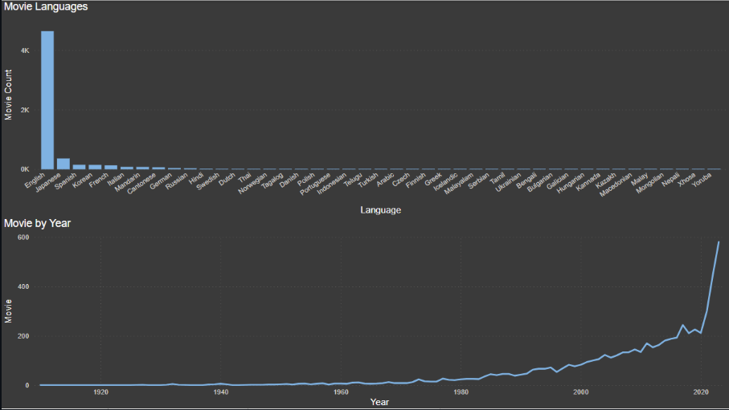
Power BI – Github Repo

Slide 14
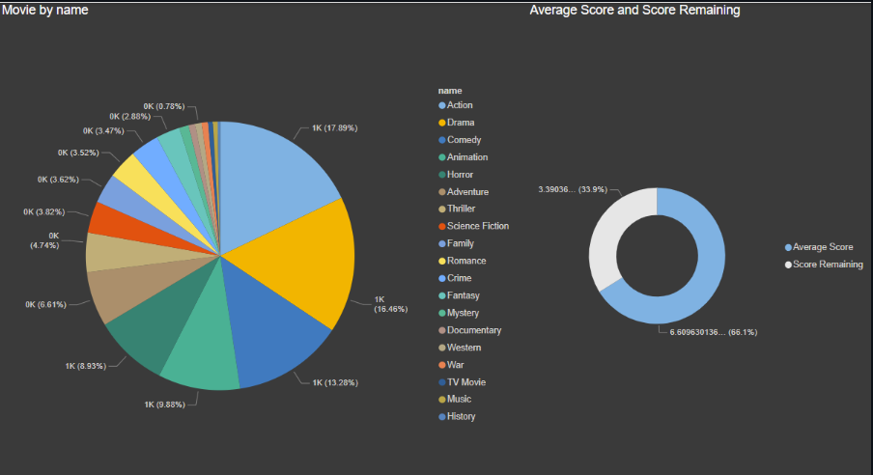
Power BI – Github Repo

Slide 15

Insights
The average popularity score is 50.30
Total Languages in the dataset is 187
Movies have an average score of 6.54
The total review count is 6M.
The total number of movie examined is 5,913

Slide 16

Insights
Movies released in the past 11 years make up majority of the popular movie at 3,100
Majority of the Popular movies are in English in the first place, Japanese in the second place, and Spanish in the third palce
The highest rated movies are Abang Adik, El Sabor de la Navidad, leave the World Behind, and Mortal World 2, all having a score of 10.00/10.00

Slide 17

Insights
The Genre most popular is Action (17.89%) followed by Drama( 16.46%) and Comedy (13.28%)
Average scores of Action Films is 6.4/10
Average scores of Drama Films is 6.8/10
Average scores of Comedy Films is 6.4/10
The least popular is Genre is History (0.3%) with an average score of 7.2/10

Slide 18

Thank you

